Slide 1
WEBDESIGN
COMPUTER DESIGN
Evolution and principles

Slide 2
Introduction
I. Computer Design in time
II. Evolution’s principles
III. Conclusion
I. Computer Design in time

Slide 3


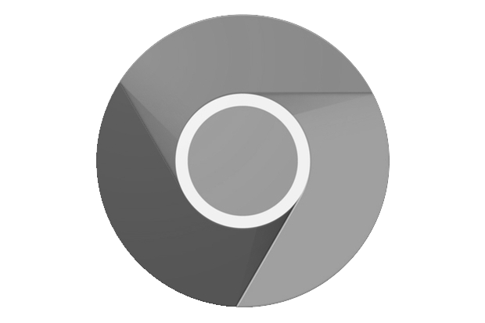




I. Computer Design in time
MATERIAL DESIGN
Skeuomorphism
MATERIAL DESIGN
Skeuomorphism
FLAT DESIGN
FLAT DESIGN

Slide 4
Introduction
I. Computer Design in time
II. Evolution’s principles
III. Conclusion
II. Evolution’s principles

Slide 5


II. Evolution’s principles
Flow of communication
Visual purity
Flow of communication
Visual purity
Rejection of artisanal
Marketing
Flow of communication
Visual purity
Rejection of artisanal
Marketing

Slide 6
Introduction
I. Computer Design in time
II. Evolution’s principles
III. Conclusion
III. Conclusion

Slide 7
III. Conclusion
NOWADAYS : Computer design is the art of Ergonomics
Design -> Art -> Communication
NOWADAYS : Computer design is the art of Ergonomics
Design -> Art -> Communication.
OPENING
Do you think this design is linked to the visual art and architecture art?

